Slide 1
Lecture 5
Topics: Objects and Classes
Chapter 9, Sections 9.1 – 9.5

Slide 2
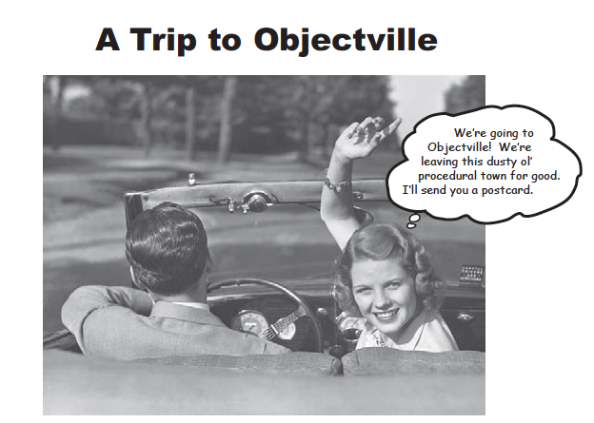
Notes:
In programming I, you put all of your code in the main method.
That’s not exactly object-oriented - in fact, not at all.
You used a few object types (like String) without realizing they were objects, but we didn’t develop any objects of our own.
We’re going to leave procedural world behind and get the heck out of main().

Slide 3
Object Oriented Programming (OOP) Concepts
Programming using objects.
An object represents an entity in the real world that can be distinctly identified.
For example, a student, a desk, a circle, a button, and even a loan can all be viewed as objects.
An object has a unique identity, state, and behaviors.
The state of an object consists of a set of data fields (also known as properties) with their current values.
The behavior of an object is defined by a set of methods.

Slide 4
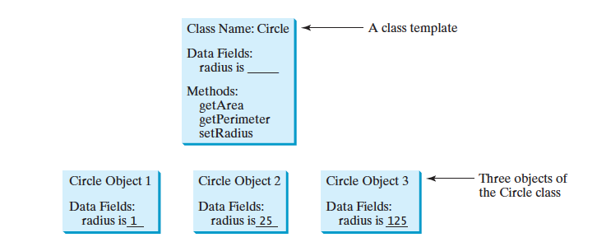
Objects
An object has both state and behavior.
The state defines the object – i.e. what are the properties of the object.
The behavior defines what the object can do.

Slide 5
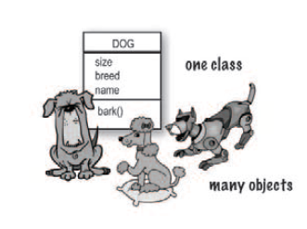
What is a class?
A class is NOT an object.
A class is a blueprint for an object.
It tells the VM how to make an object of that particular type.

Slide 6
Classes and Compiling
Each class goes in a separate .java file.
Depending on the IDE that you use, you may need to compile the classes you create independently of each other prior to using the class to make objects.
In JGrasp, this is required.
You do not "run" classes that do not have a main() method.
You only compile them.

Slide 7
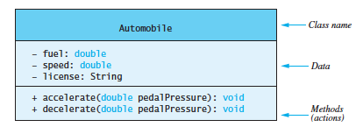
UML Diagrams
UML: Universal Modeling Language
A simple graphical notation to summarize the properties of a class.

Slide 8
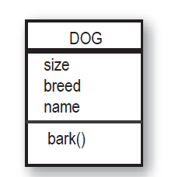
Creating your first class
Instance variables
aka fields, properties, members
UML Diagram
public class Dog
{
public int size;
public String breed;
public String name;
public void bark()
{
System.out.println("Ruff, ruff!");
}
}
+
+
+
+
Class method
In order to use this class to make objects, it needs to be compiled first.
But don’t run it!

Slide 9
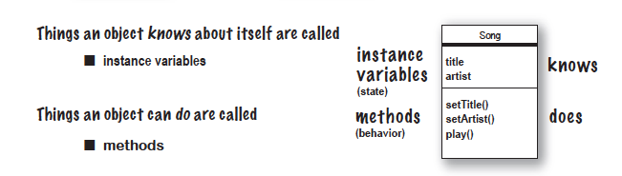
Instance Variables
The things that an object knows about itself.
They represent an object’s state (the data).
Can have unique values for each object of that type (i.e. each object made from the class blueprint).
Notes:
A note on public instance variables.
This is not good programming practice.
We’ll find out why in another lecture and how to use private appropriately.

Slide 10
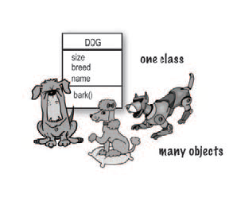
size - 50
breed - mutt
name - Rocky
size - 36
breed - robot
name - Robodog
size - 20
breed - poodle
name - Fifi

Slide 11
How do we use the Dog class to make an object?
Dog and TestDog need to be in the same folder/location.
Compile the Dog.java file first.
public class Dog
{
public int size;
public String breed;
public String name;
public void bark()
{
System.out.println("Ruff, ruff!");
}
}
The new operator is used to make a new Dog object.
Once you make a dog object, you have access to any public methods and properties.
Object variables are stored on the heap.
public class TestDog
{
public static void main(String[] args)
{
Dog ruffy = new Dog();
ruffy.size = 40;
ruffy.bark();
}
}

Slide 12
The new operator
The new operator in java is responsible for the creation of a new object (aka an instance of a class).
It dynamically allocates memory in the heap with the variable/reference name we defined pointed from the stack.
Dynamic allocation means that the memory is allocated at run-time.
It is followed by a special method called a constructor (discussed later).
Because of this, variables for objects are called reference variables.
Stack
Heap
var-name
object

Slide 13
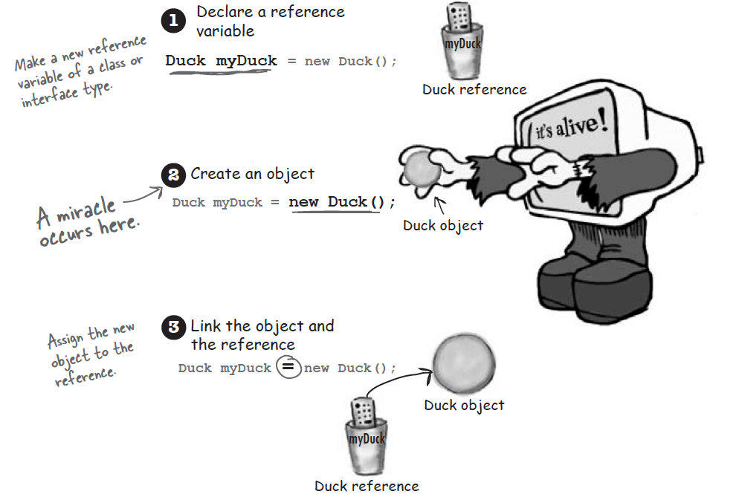

Slide 14
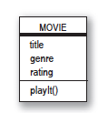
Creating another class
public class Movie
{
public String title;
public String genre;
public int rating;
public void playIt()
{
System.out.println("Playing: " + this.title);
}
}
+
+
+
+
Remember to compile before you try to make an object from the class!
Terminology: Make/create an object = Create an instance
Terminology: A class is a reference type, which means that a variable of the class type can reference an instance of the class.

Slide 15
The this keyword
Within an instance method or a constructor, this is a reference to the current object - the object whose method or constructor is being called.
You can refer to any public member (a public variable, method, etc) of the current object from within an instance method or a constructor by using this.
Using the keyword this also helps to explicitly differentiate between your instance variables (which belong to an object) and local variables (which live in your methods).

Slide 16
Using the Movie class
public class Movie
{
public String title;
public String genre;
public int rating;
public void playIt()
{
System.out.println("Playing: " + this.title);
}
}
public class TestMovie
{
public static void main(String[] args)
{
Movie one = new Movie();
one.title = "Gone with the Stock";
one.genre = "Drama";
one.rating = 1;
one.playIt();
Movie two = new Movie();
two.title = "Byte Club";
two.genre = "Action";
two.rating = 5;
two.playIt();
}
}
Output
Playing: Gone with the Stock
Playing: Byte Club

Slide 17
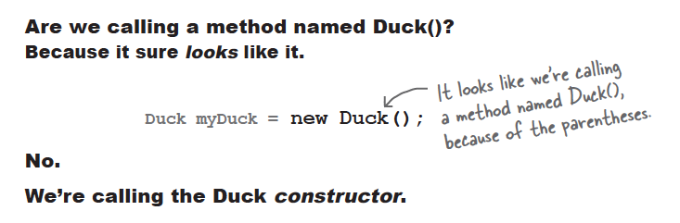
Constructors
Constructors have one purpose in life: To initialize an instance of a class.
When the object is created, Java calls the constructor first. Any code you have in your constructor will then get executed.

Slide 18
Constructor rules
A constructor must have the same name as the class itself.
Constructors do not have a return type - not even void.
Constructors are invoked using the new operator when an object is created. Constructors play the role of initializing objects.
You can have multiple constructors with the same name but with different signatures (i.e. different number of formal parameters).
Once you define a constructor for a class, Java will not define one for you.
If you have multiple constructors in a class, they must have different numbers of parameters.

Slide 19
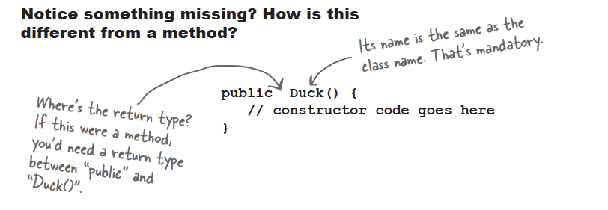

Slide 20

More constructor rules
Every class has a constructor even if you did not write it yourself.
You can write a constructor for your class, but if you don’t, the compiler writes one for you.
A constructor with no parameters is called a no-arg constructor.
The default constructor (the one the compiler provides for you) is the no-arg constructor.

Slide 21
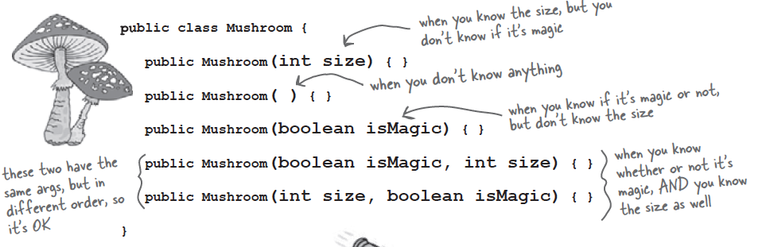

Slide 22
Why would you want to write your own constructor?
You need code to help initialize your object and get it ready for use.
Encapsulation/information hiding - maybe you only want an instance variable to be set at the time the object is created.

Slide 23
public class Dog
{
private double weight;
public void setWeight(double newWeight)
{
this.weight = newWeight;
}
}
There’s a bad thing here. The Dog object is alive at this point in the code but without a weight!
You are relying on the developer to know that creating a Dog object is a two-part process.
public class DogTest
{
public static void main(String[] args)
{
Dog newPuppy = new Dog();
newPuppy.setWeight(58.7);
}
}
This is why you would want to write your own constructor. You could initialize the variable in the constructor.
What is the value of the instance variable weight for the newPuppy object when the object is created?

Slide 24
Default values for instance variables
String: Default value of null.
int: Default value of 0.
boolean: Default value of false.
char: Default value of \u0000.
double: Default value of 0.0.
Reference variables: Default value of null.
Very important: Only instance variables have default values. Local variables do not have default values!

Slide 25

Let’s write some constructors
Stack
Heap
public class Dog
{
private String name;
public Dog(String newName)
{
this.name = newName;
S.O.P.L(this.name);
}
}
newPuppy
(Dog)
name:
Harold
Output
public class MakeANewDog
{
public static void main(String[] args)
{
Dog newPuppy = new Dog("Harold");
}
}
Harold

Slide 26
What happens if you try to use the default constructor when you wrote your own?
public class Dog
{
private String name;
public Dog(String newName)
{
this.name = newName;
S.O.P.L(this.name);
}
}
If you write your own constructor, the compiler will no longer provide you with a default constructor!
The code will not compile.
public class MakeANewDog
{
public static void main(String[] args)
{
Dog newPuppy = new Dog("Harold");
Dog newPuppy2 = new Dog();
}
}

Slide 27
Example
public class Duck
{
private int size;
public Duck()
{
this.size = 30;
}
public Duck(int newSize)
{
this.size = newSize;
}
}
Stack
Heap
(Duck)
size: 0
30
defaultDuck
(Duck)
size: 0
22
specialDuck
public class MakeANewDuck
{
public static void main(String[] args)
{
Duck defaultDuck = new Duck();
Duck specialDuck = new Duck(22);
}
}

Slide 28

That’s all for today!
Homework #3 is posted on the course website.
Due: Thursday, 02/04/16 by 9:00 a.m.

